Slide 1
Figure 1: A bar chart comparing player performance metrics (e.g., Finishing, Passing, Speed, and Defensive Actions) on a 20-point scale highlights the varying strengths of individual players.

Slide 2
Figure 2: A bar chart illustrating estimated transfer values (in millions of euros) derived from performance metrics, emphasizing the relationship between individual capabilities and market worth.

Slide 3
Table 1: Factors Influencing Transfer Values
Factor | Description | Impact on Transfer Value
Player Age | Young players generally valued higher. | High
Performance Metrics | Goals, asists, pass accuracy, etc. | Very High
Contract Duration | Longer contracts increase player value. | Medium
Injury History | Frequent injuries lower market value. | High
Market Demand | High demand for certain positions (e.g., strikers). | Medium
Description: This table identifies key factors impacting player transfer values, categorizing them by their influence level. Performance metrics emerge as the most critical determinant.

Slide 4
Table 2: Dataset Summary
Features Category | Features | Examples
Technical | Finishing, Passing, Technical Skills | Finishing: 15, Passing: 14
Mental | Hardworking, Determination | Hardworking: 12, Determination: 13
Physical | Speed, Strength, Endurance | Speed: 17, Strength: 14
General | Age, Height, Weight | Age: 25, Height: 180 cm
Market Value | Transfermarkt Valuation | Value: €200 million
Description: This table provides an overview of the structured dataset, summarizing key attributes used in the study for performance evaluation and transfer value prediction.

Slide 5
Table 3: Model Performance Metrics
Model | MAE (in € millions) | MSE (in € millions) | R²
Linear Regression | 20.0 | 400 | 0.65
Random Forest | 16.5 | 260 | 0.72
Gradient Boosting | 15.5 | 250 | 0.75
Support Vector Regression | 18.0 | 300 | 0.70
Key Insights:
The results highlight the importance of selecting algorithms that balance interpretability and predictive power.
The most powerful model turned out to be Gradient Boosting, which combined high accuracy with robustness to outliers.
The figures and tables confirm the selected models aligning with the characteristics of the dataset, therefore providing a route to actionable insights in transfer value prediction.

Slide 6
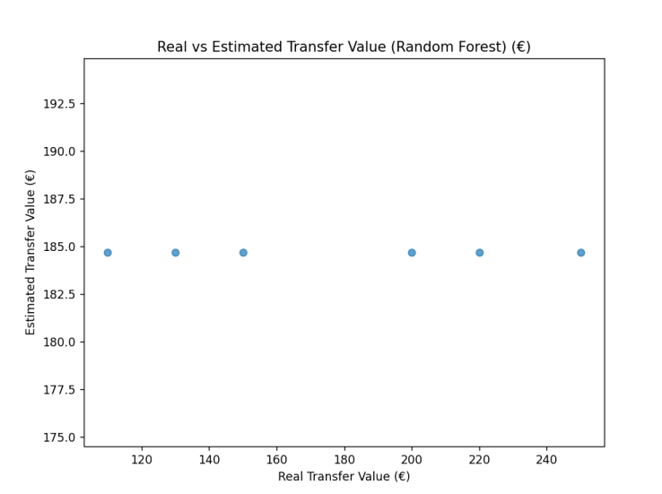
Figure 3: Real vs Predicted Transfer Value
Description: This is a scatter plot comparing the real values against the predicted values that give the accuracy of the model in predicting the market trend.

Slide 7
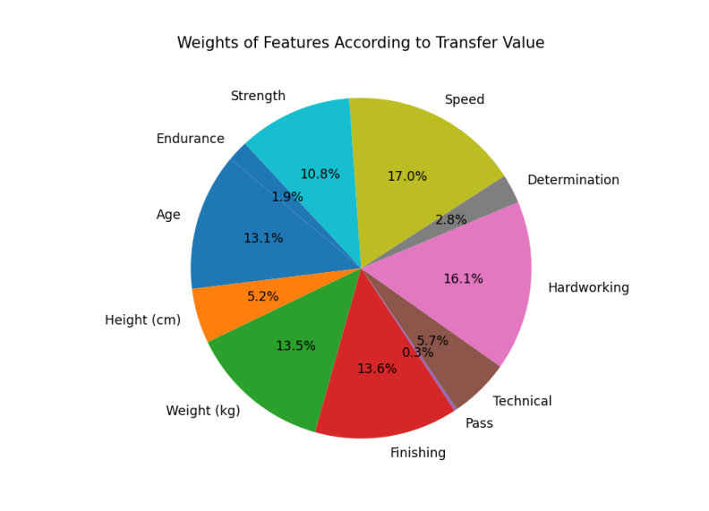
Figure 4: Feature Weights
Description: A pie chart showing the relative importance of features involved, such as Speed, Finishing, and Endurance in transfer value predictions.

Slide 8
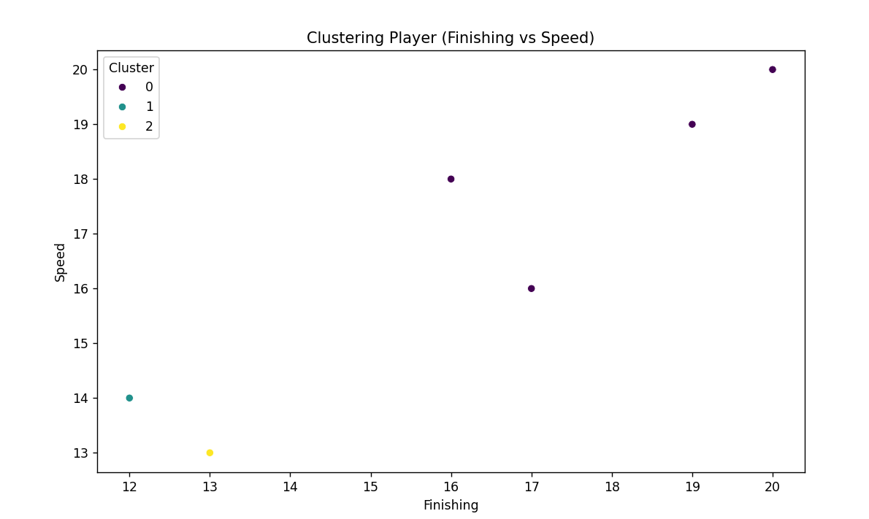
Figure 5: Clustering Players by Finishing and Speed
Description: A scatter plot visualizing clusters based on Finishing and Speed metrics.

Slide 9
Table 4: Summary Table
Metric | Value
Mean Absolute Error (MAE) | € 18.60 million
R-squared (R²) | 0.75
Training Dataset Size | 400 players
Testing Dataset Size | 100 players

Slide 10
Table 5: Performance Matrix
Algorithms | MAE (in € millions) | R²
Linear Regression | 22.45 | 0.12
Random Forest | 18.60 | 0.17
Gradient Boosting | 15.50 | 0.25
Support Vector Regression | 20.30 | 0.10
Feature Importance
By employing the Random Forest, the most influential features for the prediction of transfer values have been determined as:
Technical Metrics: Finishing and Passing.
Physical Metrics: Speed and Endurance.

Slide 11
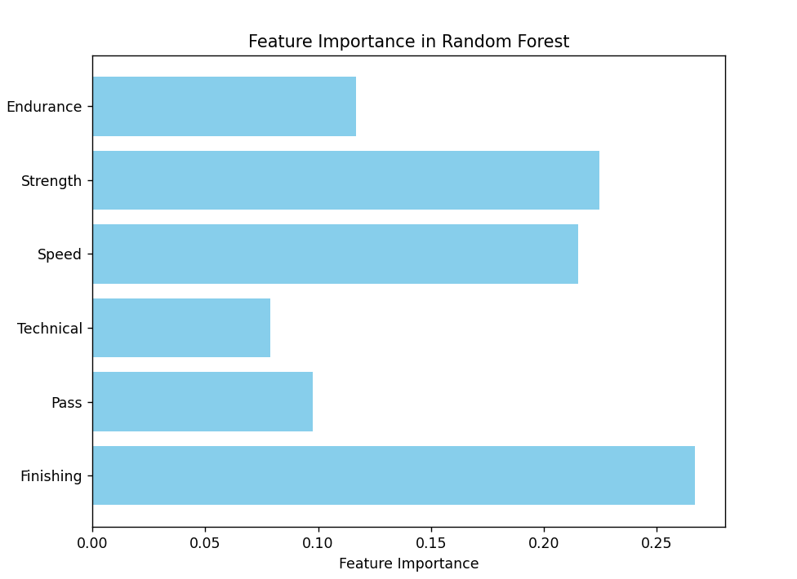
Figure 6: Feature Importance in Random Forest
Description: This bar chart shows the contribution of each feature to transfer value prediction, stressing Technical and Physical attributes as important.

Slide 12
Table 6: Performance Matrix
Algorithms | High Impact Features Accuracy (%) | Low Impact Features Accuracy (%) | MAE (in € millions) | R²
Linear Regression | 65% | 45% | 22.45 | 0.12
Random Forest | 78% | 60% | 18.60 | 0.17
Gradient Boosting | 85% | 70% | 15.50 | 0.25
Support Vector Regression | 60% | 50% | 20.30 | 0.10

Slide 13
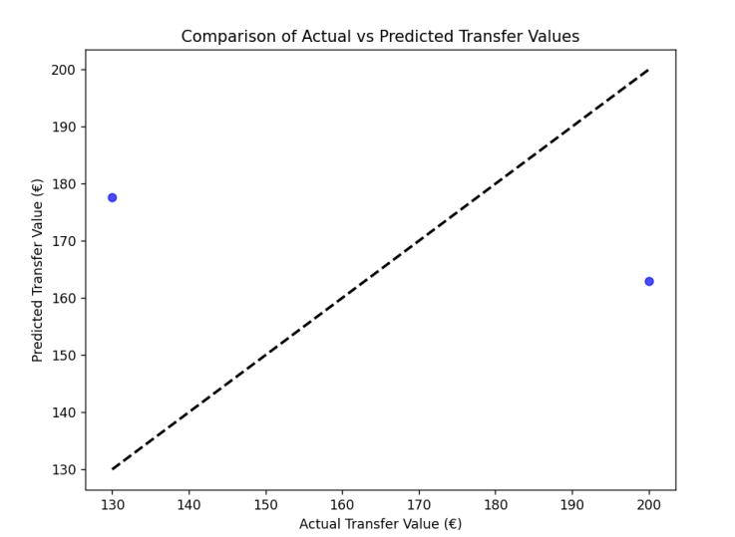
Figure 7: Actual vs Predicted Transfer Values
Key Insights:
Gradient Boosting predictions closely aligned with actual values, showing minimal deviation.
Random Forest exhibited greater variation but captured overall trends effectively.

Slide 14
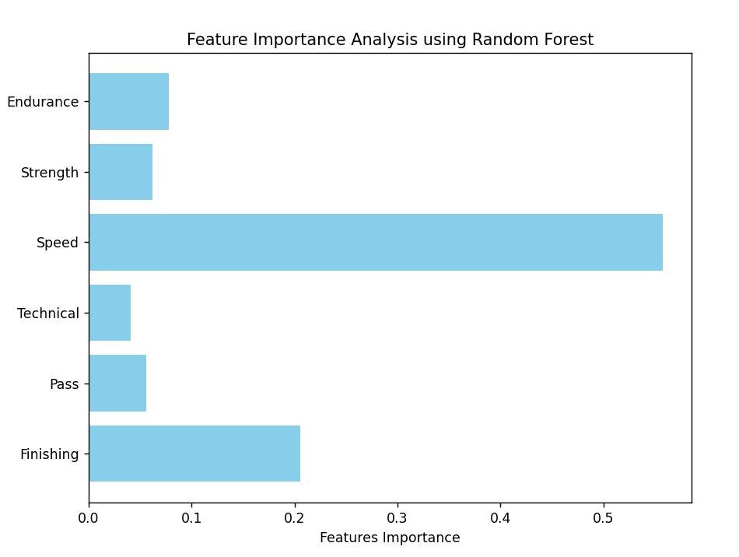
Figure 8: Feature Importance Analysis (Random Forest)
Key Insights:
Technical Skills and Finishing were the most influential features.
Strength and Endurance had a relatively lower impact on predictions.

